Slide 1
Policy Working Group on
Sustainable Development
Chair: Roberto Suárez Santos in place of James Pearson
Adviser: Pierre Vincensini
Geneva, Tuesday 20 March 2018

Slide 2
AGENDA
Slide Title (Calibri body, 44, White)
Welcome and introduction by Roberto Suárez Santos (5mins)
Presentation by Henrik Munthe, Confederation of Norwegian Enterprises (NHO) (10 mins)
Delivering on the SDGs: the role of the Confederation of Norwegian Enterprise (NHO)
Presentation by Natalia Hoffman, Russian Union of Industrialists and Entrepreneurs (RSPP) (10 mins)
Companies best practices to achieve the SDGs
Presentation by Norine Kennedy, United States Council for International Business (USCIB) (10 mins)
The Business for 2030 website
Roundtable discussion / questions (20 mins)
Concluding remarks (5 mins)

Slide 3
Delivering on the SDGs: the role of the Confederation of Norwegian Enterprise
Business as usual is not sufficient
No consensus on how to reach those goals
But none of the goals will be met without Business
Business should take a wider responsibility
Focus should be set on opportunities (solutions and technologies to the planet’s challenges)
NHO report project to highlight business’ drive to contribute to the goals
New ways of cooperating with governments and civil society (strategic partnerships)
Take a more active role in implementing the SDG (in emerging markets)
Also use the SDGs as a platform for developing new policies or services
Job creation, the Green shift, Gender equality, etc.
Presented by Henrik Munthe

Slide 4
Companies best practices
to achieve the SDGs
Video : http://rspp.ru/video/view/271?s=8
Presented by Natalia Hoffman

Slide 5
Study Main targets:
To extend the horizon
To improve the image
To extend the capacity and quality of Reporting
To get better understanding where we ,as business, are standing with SDGs in Russia

Slide 6
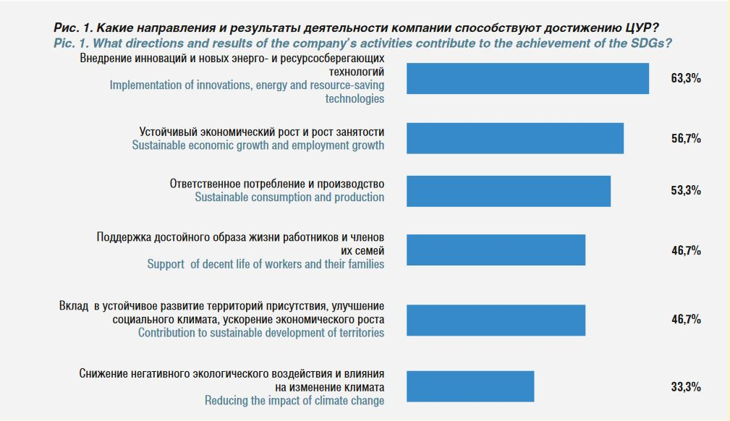
RSPP Survey 2017 Distribution of answers (preliminary survey to get a feeling on what are the companies knowledge about SDGs)

Slide 7
Background (PWC survey for 2017 and RSPP’s for 2017, based on the Companies Non -Financial Reports )

Slide 8
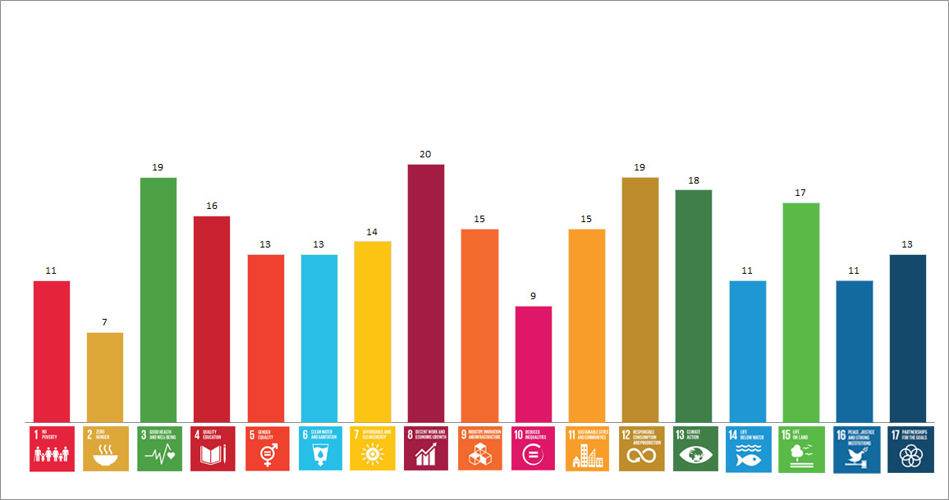
Russian Business SDGs priorities
Most mentioning SDGs :
Goal 8. Promote sustained, inclusive and sustainable economic growth, full and productive employment and decent work for all
Goal 3. Ensure healthy lives and promote well-being for all at all ages
Goal 12. Ensure sustainable consumption and production
Goal 13. Take urgent action to combat climate change and its impacts

Slide 9
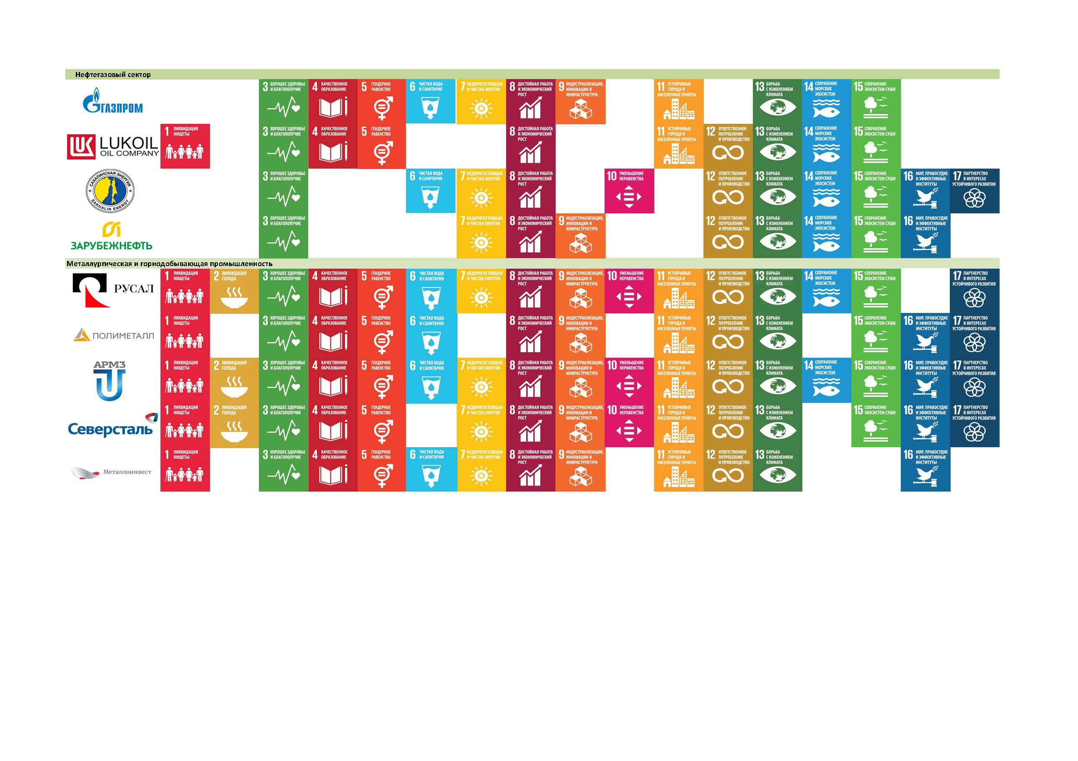
sdgs Overview among the companies ones taking part in the publication and the Survey : Oil and Gas Sector : LLC Gazprom, pjsc “LukOil”, Sakhalin Energy, Zarubegneft Mining and smelting industries : Uc RUSAL, polimetall, ARMZ, METALLOINVEST

Slide 10
Constrains:
Lack of understanding
Complicity of Targeting
Lack of capable staff
Lack of platforms and informational sources for promotion and Best-practices sharing and distribution
Using a chance please go to the link and get acquainted with our publication http://media.rspp.ru/document/1/b/2/b24091d44c9660fcf3a9fdad6551b88f.pdf

Slide 11
The Business for 2030 website
http://www.businessfor2030.org/
Presented by Norine Kennedy

Slide 12
Chair: James Pearson
Advisor: Pierre Vincensini
For more information:
vincensini@ioe-emp.com
www.ioe-emp.org

